Slide 1

Revolutionizing Resume Screening with NLP & Transformers
The future of HR is here, leveraging AI for smarter hiring decisions. We automate and accelerate candidate selection with cutting-edge technology.

Slide 2
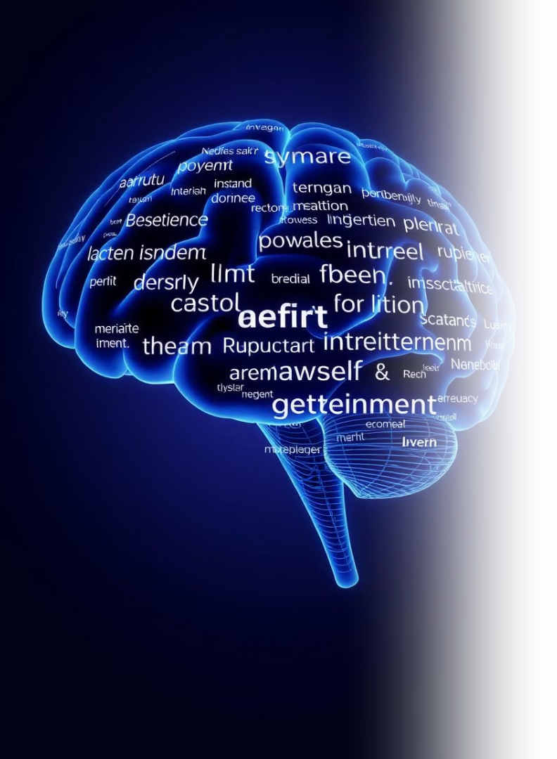



What is NLP? (Natural Language Processing)
Read Language
Computers learn to "read" human language.
Understand Meaning
They grasp context and nuances of text.
Automate Tasks
Powers tools like spam filters and chatbots.
NLP gives computers the ability to understand human language. It's like teaching a machine to comprehend text, enabling applications from voice assistants to sentiment analysis.

Slide 3








Transformers: The NLP Game Changer
Contextual Understanding
Nuanced Analysis
Understands word relationships in sentences.
Provides highly accurate text interpretation.
Advanced AI
Unlocks Resume Potential
Sophisticated models like BERT and GPT.
Crucial for deep resume insights.
Transformers are advanced AI models that revolutionize NLP. They focus on word relationships, leading to more accurate and nuanced text understanding. This is key to unlocking advanced resume analysis.

Slide 4

How NLP & Transformers Screen Resumes
Extract Key Data
Skills, experience, and education are identified.
Match Requirements
Candidates are automatically aligned with job needs.
Rank Relevancy
Resumes are ordered by qualification and fit.
Find Hidden Talent
Potential and subtle fits are uncovered.
NLP and Transformers extract vital information like skills and education. They then match candidates to job requirements, ranking resumes for relevancy. This helps identify hidden talents, especially useful for large applicant pools.

Slide 5

Benefits of AI-Powered Resume Screening
50%
Time Saved
Automate tedious screening tasks.
100%
Bias Reduced
Objective, data-driven decisions ensure fairness.
High
Accuracy
Find the best candidates faster.
Enhanced
Efficiency
Streamline your entire hiring process.
AI-powered screening saves significant time by automating tasks. It reduces bias for objective decisions, improving accuracy in finding top talent. This enhances overall hiring efficiency.

Slide 6

Real-World Examples
Google
Uses AI for initial resume screening, saving recruiter hours and streamlining hiring.
LinkedIn
Leverages AI for powerful talent matching suggestions, connecting candidates to roles.
iCIMS
Automates the candidate matching process for improved recruitment workflows.
Taleo (Oracle)
Oracle's cloud-based talent management platform uses AI for various HR functions.
Leading companies like Google and LinkedIn utilize NLP for resume screening. iCIMS and Taleo also automate candidate matching, demonstrating widespread adoption of AI in HR.

Slide 7




The Future of Hiring is Intelligent
Transform HR
Embrace AI
NLP and Transformers are reshaping recruiting.
Find top talent with intelligent efficiency.
Get Ahead
Start leveraging NLP for resume screening now.
NLP and Transformers are set to transform HR. Embrace AI to find top talent efficiently and get ahead. The future includes integration with video interviews and personality assessments for comprehensive hiring.

